Slide 1

WHY IS MENTAL HEALTH A CONCERN?
This is because no being deserves to be BLANK!

Slide 2

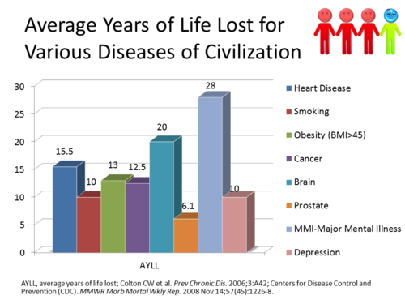

Slide 3
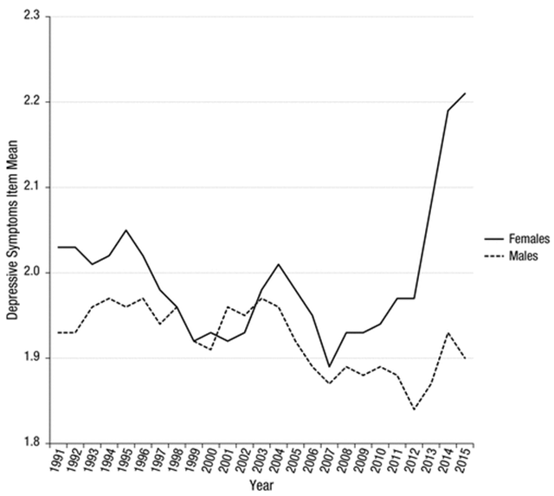
Increase in depressive symptoms over years

Slide 4
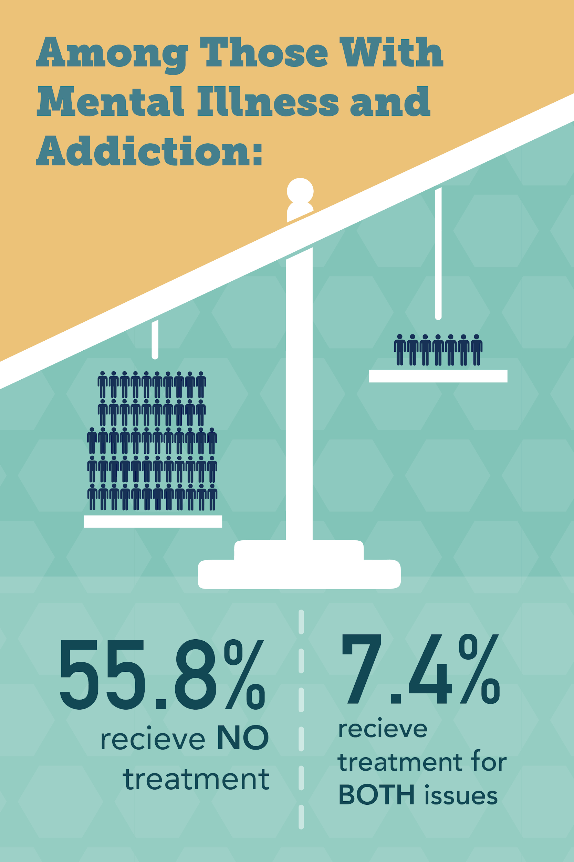
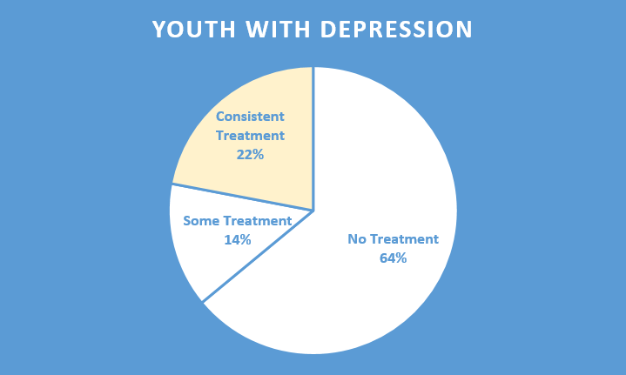
Ques.) Why are people not receiving treatment?
Financial or societal pressure
Aren’t aware of their OWN state
Issue undiagnosed

Slide 5
TEAM BLACK PEARL:
VISHAL JHA
SIMRANJEET SINGH
NETAJI SUBHASH UNIVERSITY
OF TECHNOLOGY, DELHI

Slide 6
PROBLEM STATEMENT: We are aware of the existence of major psychological disorders yet we are still struggling with their diagnosis & cure!

Slide 7
Smart Encephalography
Better Care and better Understanding

Slide 8
BIPOLAR DISORDER aka MANIC DEPRESSION
: Emotional highs (mania) and lows (depression)
Suicidal Ideation
Stroke
Drug abuse
Anxiety
Insomnia
Euphoria
High Energy
Loss of decision making ability
Cyclothymic Disorder (this is symptom)

Slide 9
Causes of the disorder:
Genetic (genes unknown!)
Biological difference ( structural changes in brain, reason unknown!)

Slide 10
OUR VISION:
Concentrating the application of SEG i.e. Smart Encephalography upon the Alpha Brain waves in order to know the mental state of the being.
A positive traits imply mania.
A negative traits imply depression.

Slide 11
Why E.E.G.?
The human brain affected from Bipolar disorder undergoes untraceably rapid emotional changes. In order to recognise the change in emotions, tracing the undulation of the neurological signals proves to be the precise approach.

Slide 12
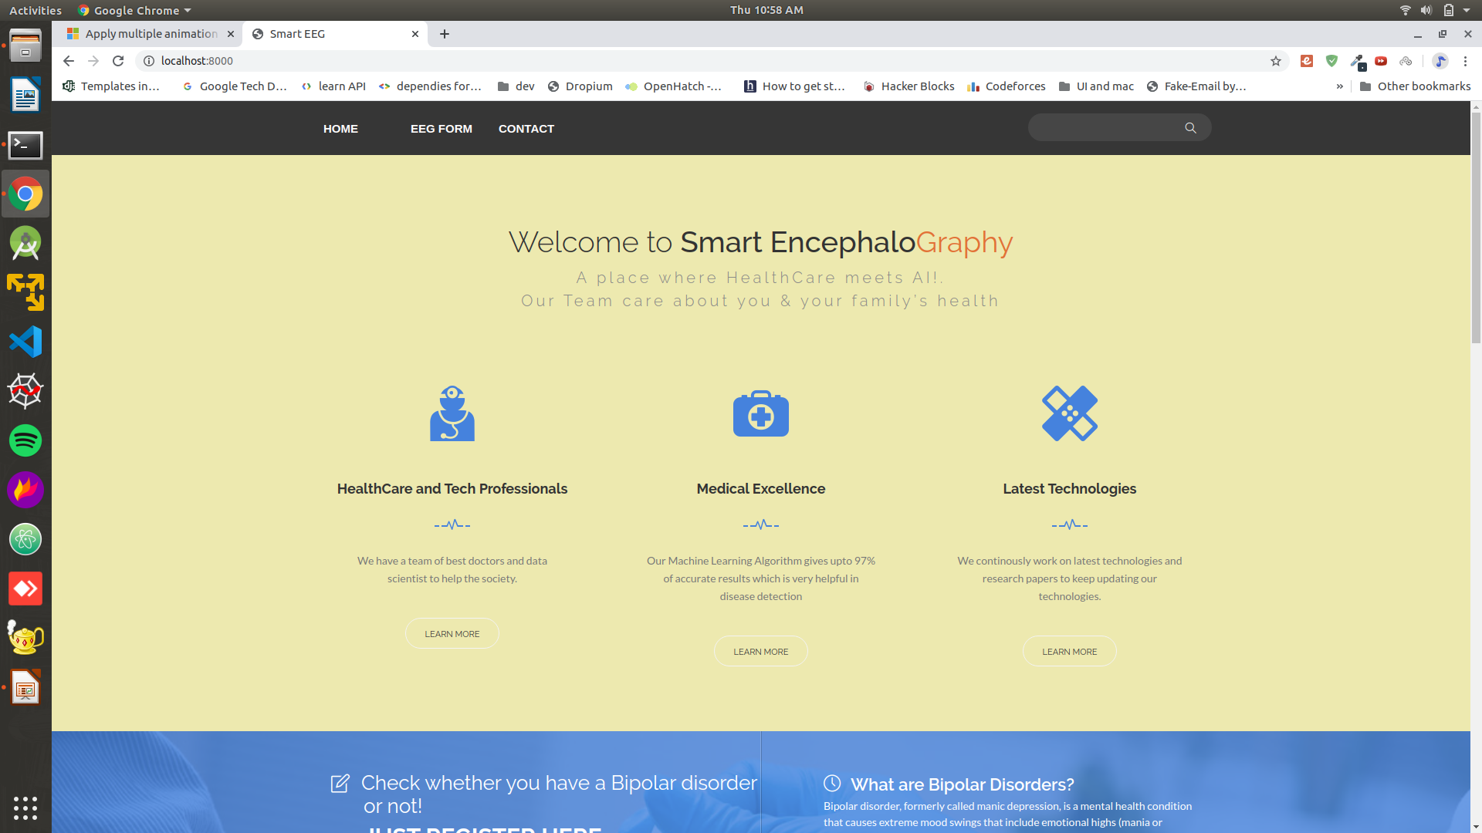
Project View

Slide 13
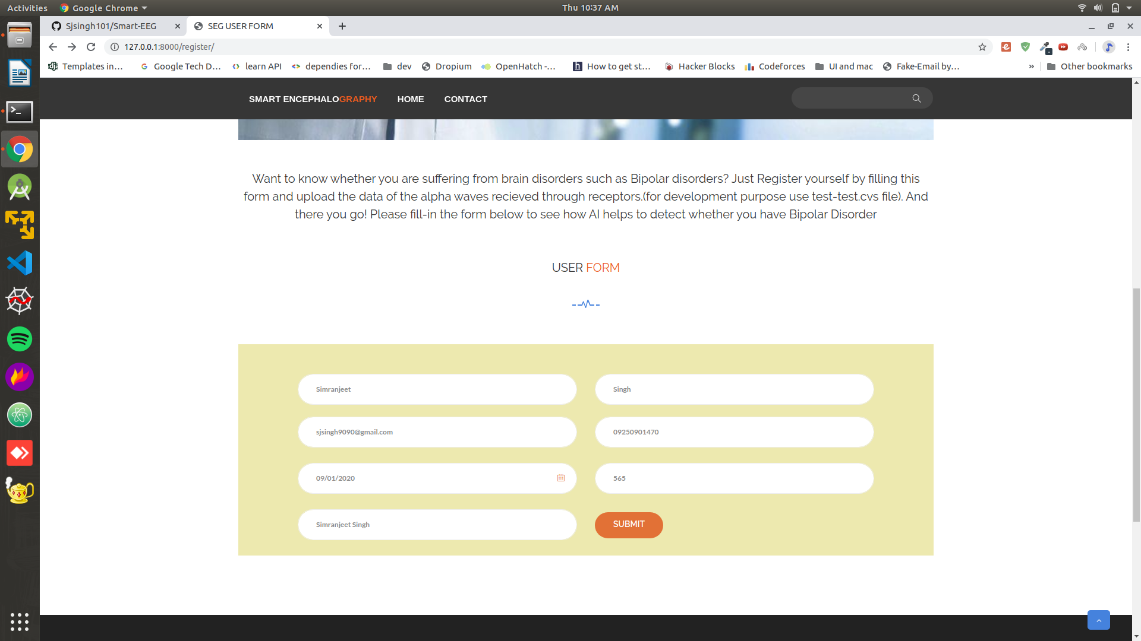
Project View

Slide 14
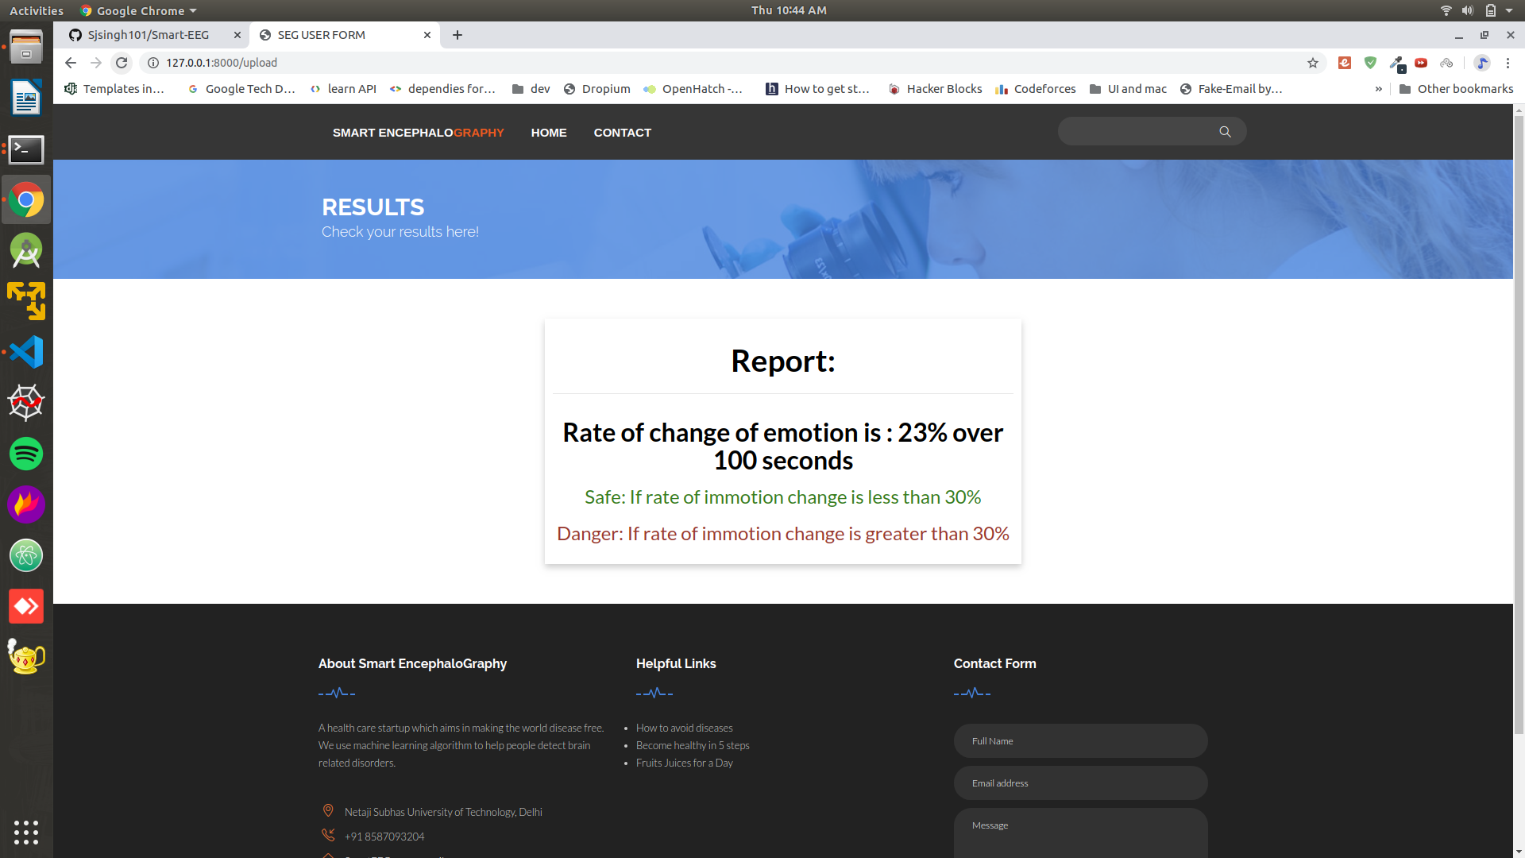
Project View

Slide 15
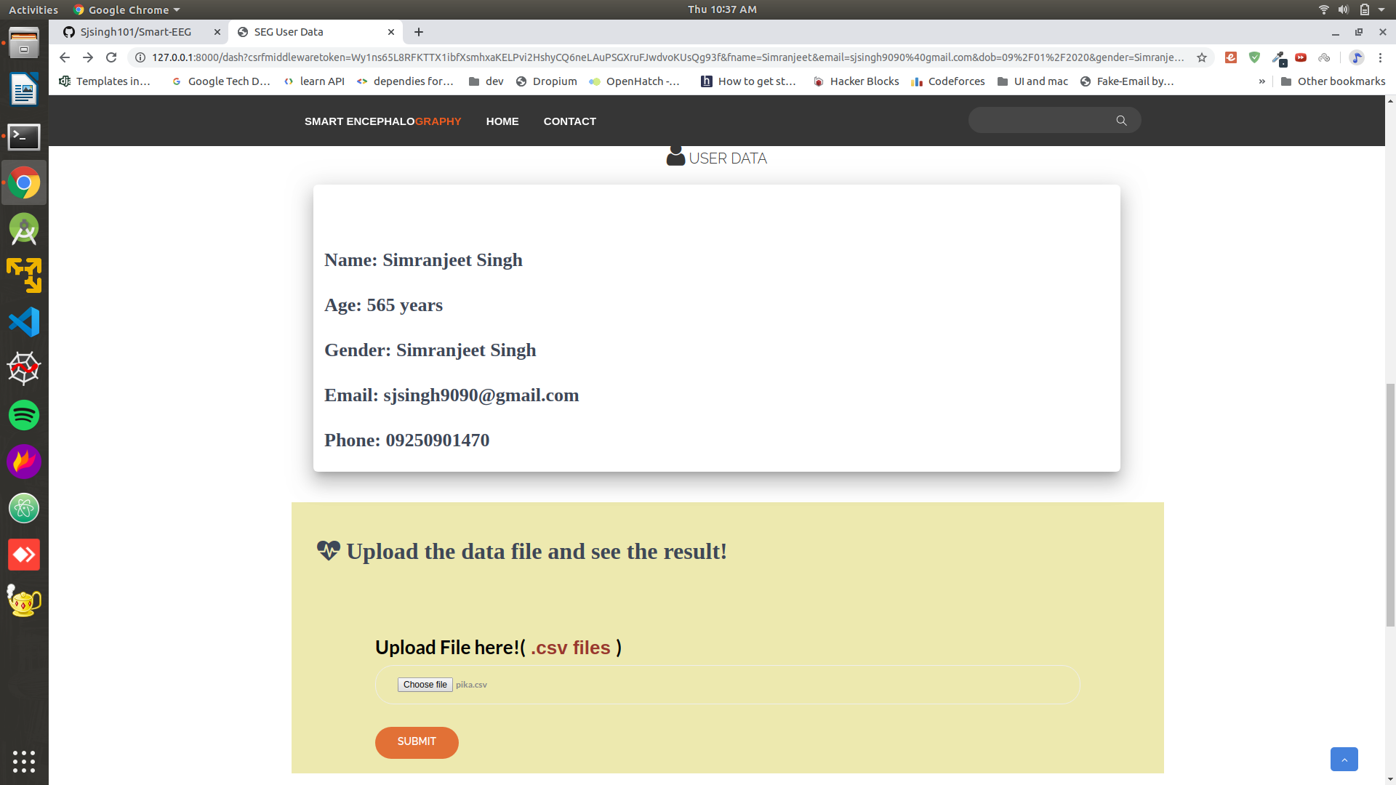
Project View

Slide 16
“We need machines, but more than that we need humans who know how to use those machines for the greater good.”
IN HOLD OF A HAPPIER FUTURE,
TEAM BLACK PEARL.

